Slide 1
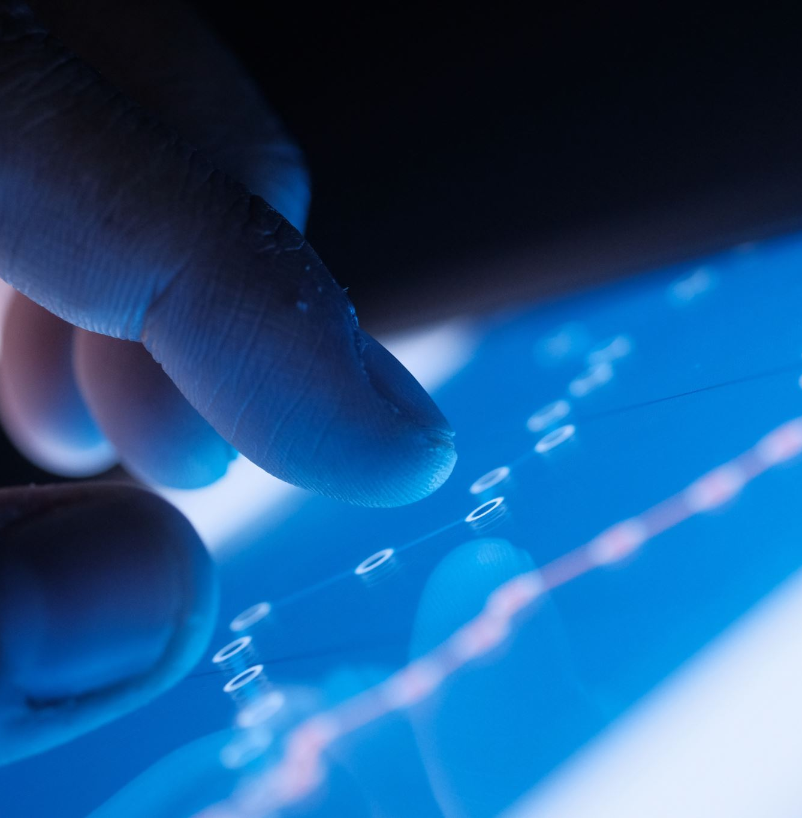
Predicting Smartphone Prices Using Machine Learning
Model Development and Analysis
Author: Hammad Ur Rahman

Slide 2
Dataset Overview
The dataset contains the following key features:
RAM
MEMORY
BATTERY
REAR CAMERA
FRONT CAMERA
PROCESSOR
PRICE
SOURCE: PROCESSED_FLIPDATA.PDF

Slide 3

Introduction
The project aims to predict mobile prices based on key features such as RAM, Memory, Battery, Processor, and Camera.
Data preprocessing, exploratory data analysis, and mobile building are key steps to achieve the prediction.

Slide 4
DATA PREPROCESSING
Dropped unnecessary columns like ‘Unnamed’.
Handled categorical features using Label Encoding (Processor, Camera).
Scaled the numerical features using StandardScaler to bring all features to the same scale.

Slide 5
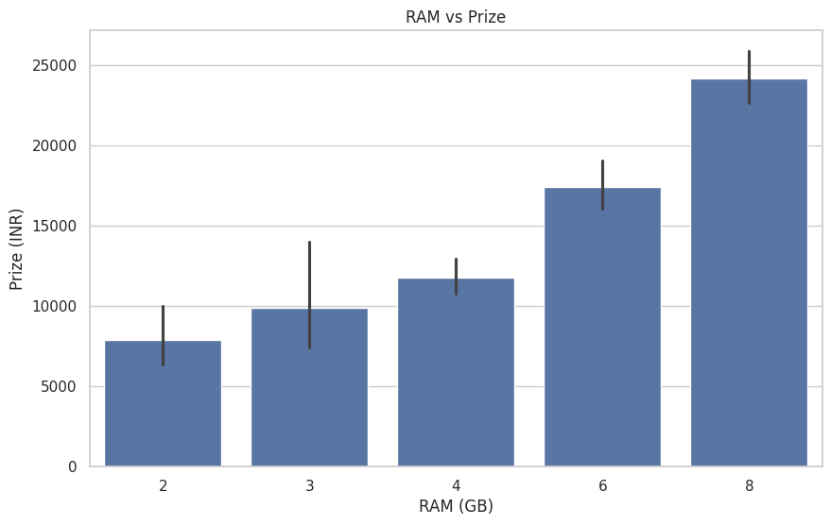
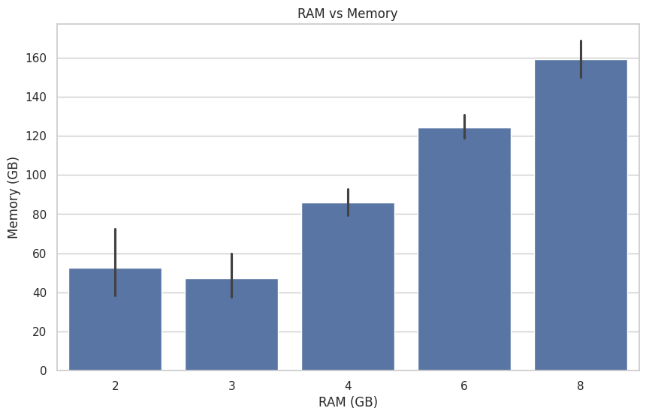
Exploratory data analysis (eda)
Visualizations of RAM, Memory, and Price distributions using histograms.
Correlation Matrix showing the relationships between features.
Key insights: RAM and Memory have a strong positive correlation with price.

Slide 6
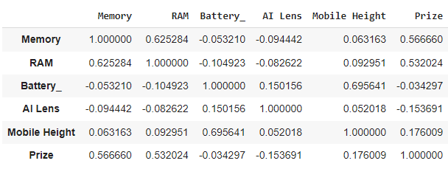
FEATURE IMPORTANCE ANALYSIS
RAM and Memory have a strong correlation with price.
Mobile Height also plays a significant role.
Battery capacity has a lower influence on price.

Slide 7

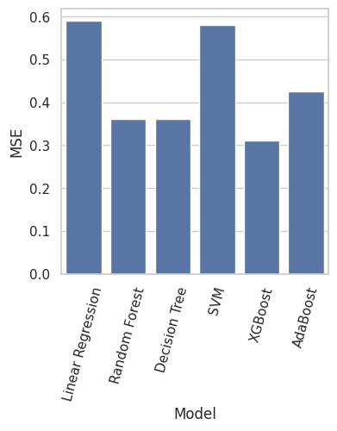
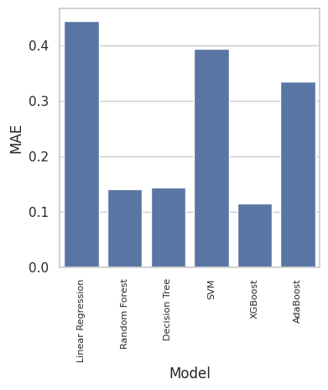
Best performance algorithm
XGBoost outperformed other models due to its ability to handle complex relationships in the data.

Slide 8

FINAL REPORT AND RECOMMENDATIONS
Insights on mobile prices indicate:
Memory, RAM, and Mobile Height significantly influence pricing.
Recommendations:
Focus on optimizing features like RAM, Memory, and Mobile Height for cost-effective models.
Further analysis can enhance prediction accuracy.

Slide 9
CONCLUSION
This project successfully developed a predictive model for mobile prices using various algorithms, highlighting the importance of feature selection and data preprocessing.

Slide 10

THANK YOU
I appreciate your time and attention.
For further queries or detailed analysis, feel free to reach out.
Contact Information:
HAMMAD UR RAHMAN
Email: hammadrahman446@gmail.com
Phone: +91 9410583350

